Slide 1

Command Line Basics 1/2
Linux Essentials

Slide 2
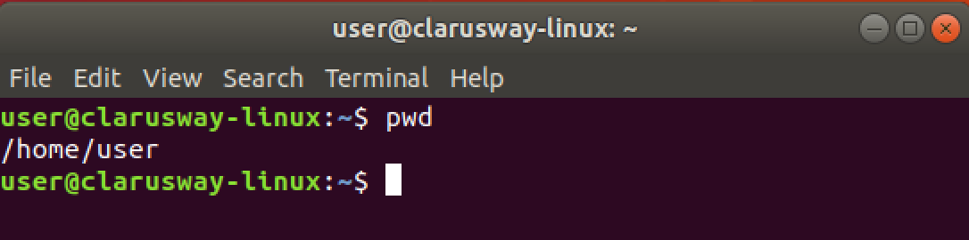
Basic Shell Commands
pwd show current path
(print working directory)
Notes:
Though you can see the current path on your command prompt, the most used command, in my opinion, is pwd.
It is my habit to look and confirm my working directory by using this command. Especially if you are the root user, it becomes more important to know where you are on the system. I do also suggest you use this command first ..
Let’s do it together please...

Slide 3
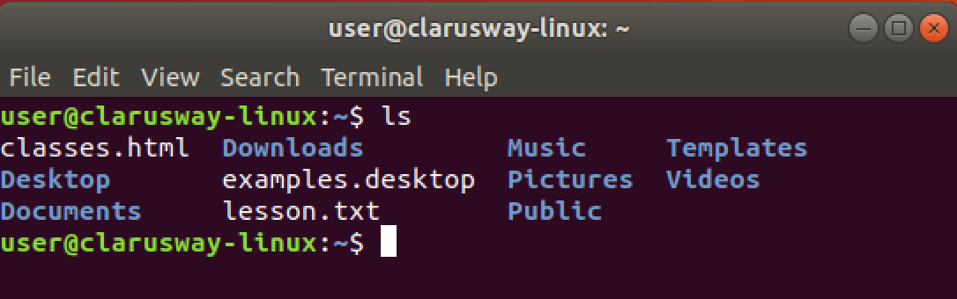
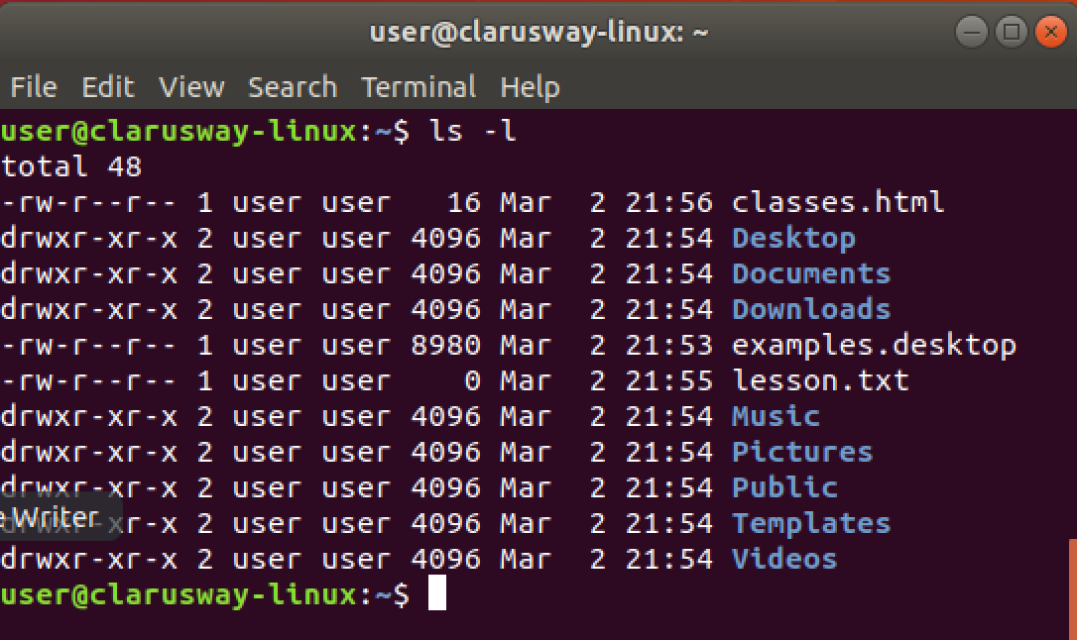
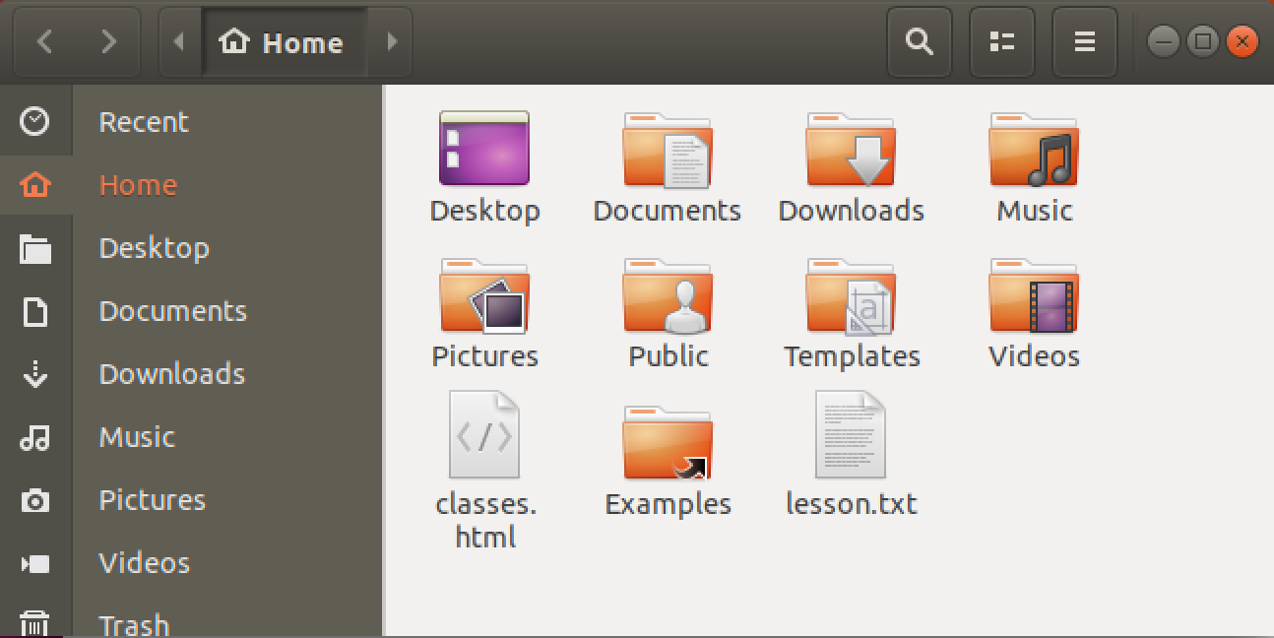
Basic Shell Commands
ls lists directory contents
ls -l lists directory contents with details
ls -a lists directory contents with
hidden folders and files
ls -al lists folder contents with hidden
files/folders and their details.
Notes:
ls, means list directory contents, is the most used command with pwd in Linux, I think.
It has many arguments, I mean options.
ls -l, ls -a, and ls -al are mostly used options for ls command. it should be space between options and command
Let’s check the contents of our current directories with different arguments.

Slide 4
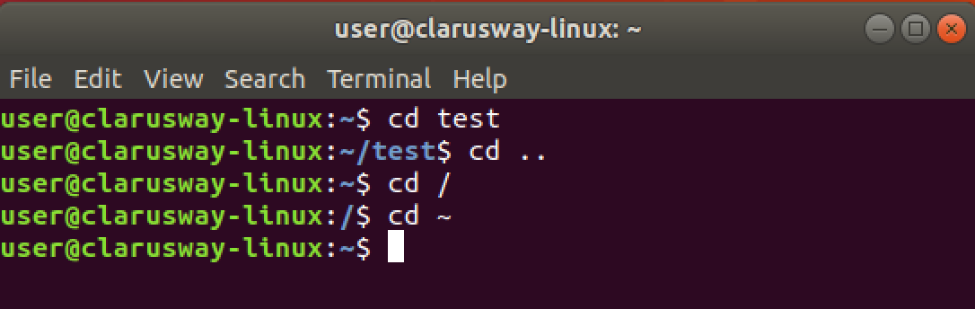
Basic Shell Commands
cd [dir] change (current) directory
cd .. change current directory
to one level up
cd / change current directory
to the root directory
cd ~ change current directory
to the home directory

Slide 5
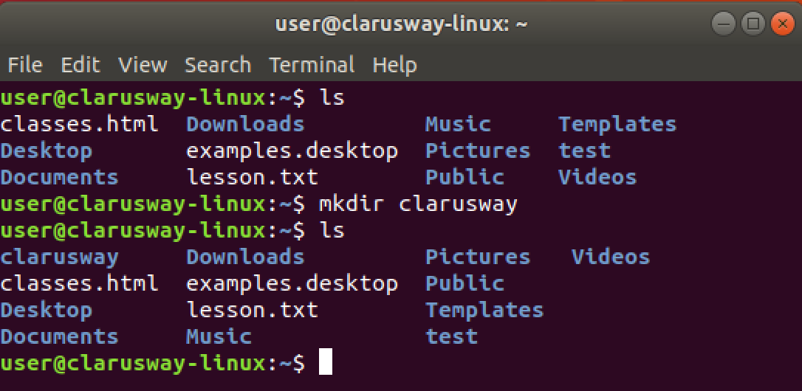
Basic Shell Commands
mkdir [dir] (make directory) create a new directory

Slide 6
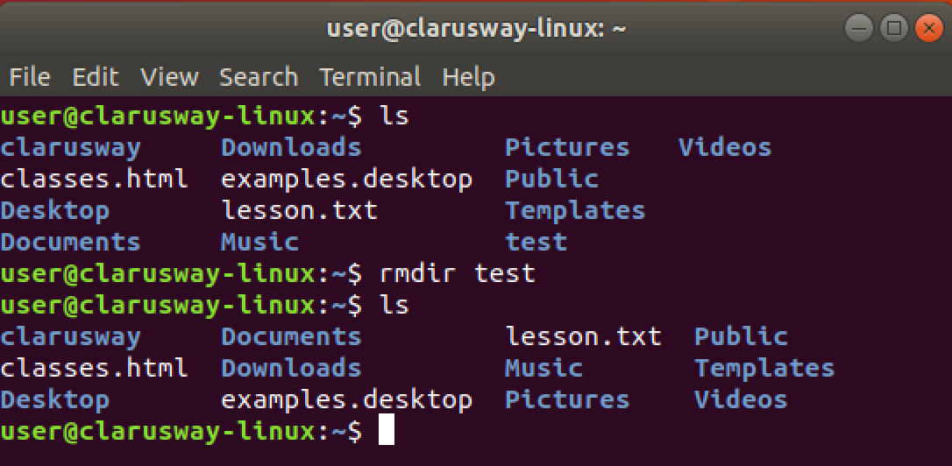
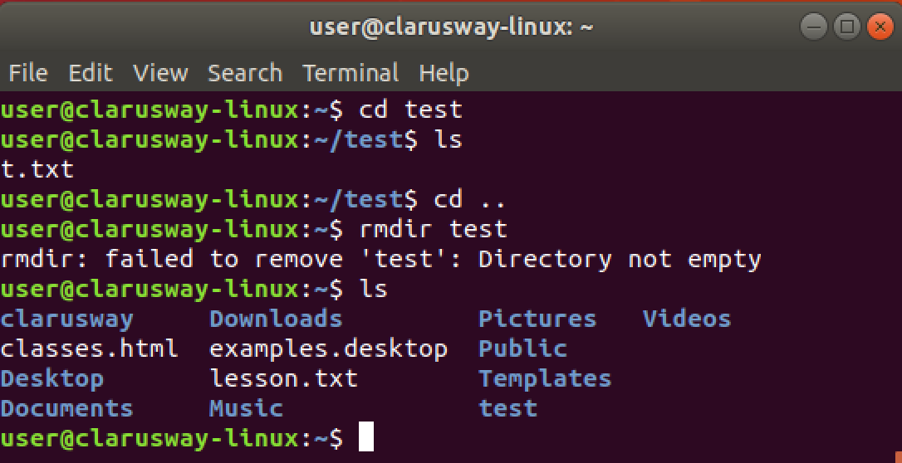
Basic Shell Commands
rmdir [dir] (remove directory) delete an empty directory
! It works if the folder content is empty, otherwise it gives a warning.

Slide 7
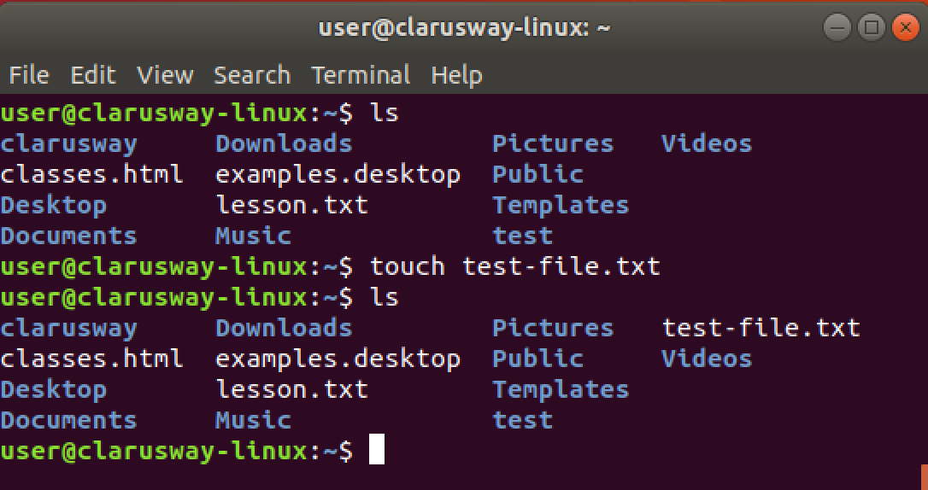
Basic Shell Commands
touch [filename] create a file
Notes:
to create an em

Slide 8
Basic Shell Commands
Quick Tips
mkdir dirname{1..10}
touch filename{a..z}
Notes:
Rmdir *
İçi dolu ise rm –r *
Rmdir ./FullStack/listeler
Rm –r ./fullStack/listeler
Mkdir ../denemeler üst dizinde oluştur
Mkdir –p Linux/denemeler/listeler hepsini oluşturur
Mkdir --help
Clear
Cat .bashhistory

Slide 9


Case Sensitivity
Most of the common Linux file systems are case sensitive; this is something to keep in mind when creating files or directories and moving through directories.
Lower-case and upper-case letters have different ASCII representation.
touch newfile
touch Newfile
Will create two different files.
Notes:
Let’s try together:
touch newfile
touch Newfile
ls -l
uppercase letter
lower case

Slide 10
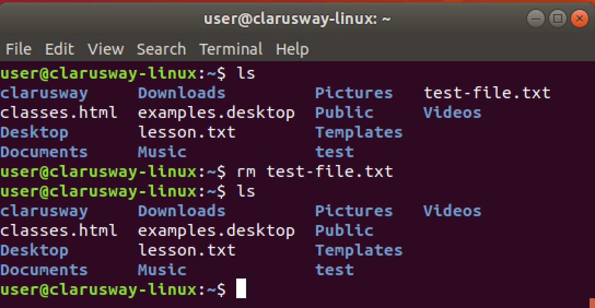
Basic Shell Commands
rm (remove) delete a file

Slide 11
Basic Shell Commands
rm -d directoryname = rmdir directoryname
rm -r directoryname
rm -f Remove all files in the working directory.
rm -rf rm will not prompt you for any reason before deleting them

Slide 12
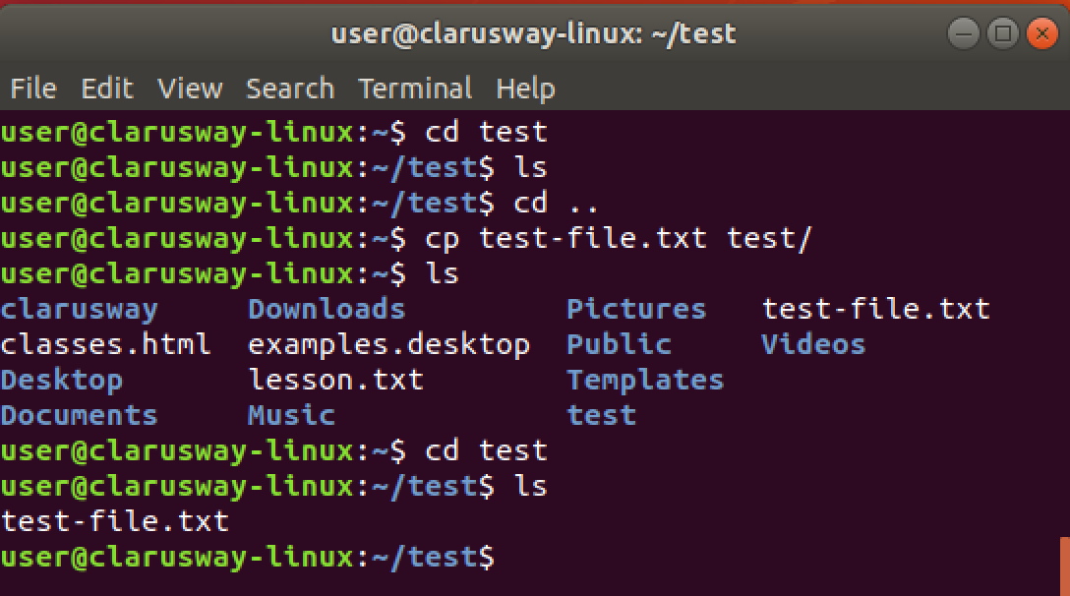
Basic Shell Commands
cp copy a file to another location

Slide 13
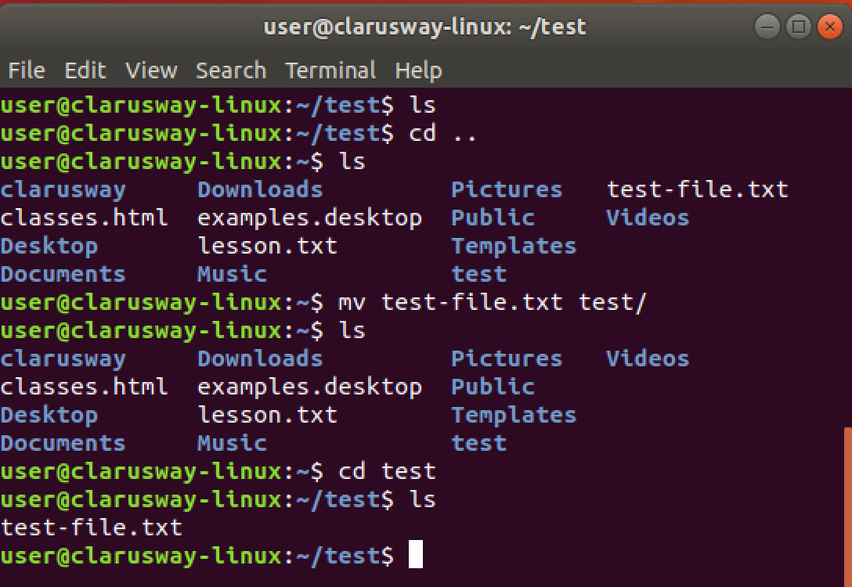
Basic Shell Commands
mv move a file to another location

Slide 14
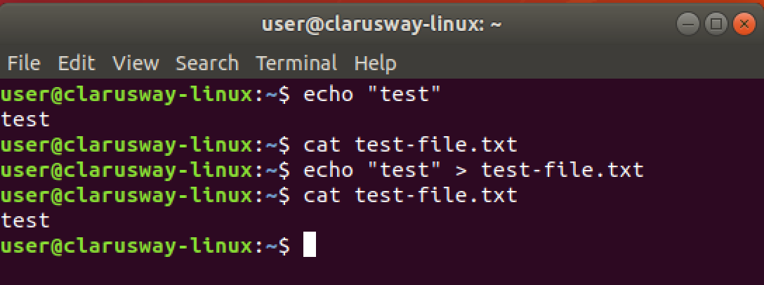
Basic Shell Commands
echo print message to screen
echo > [file] print message into a file
if the file doesn't exist it creates
echo >> [file] adds to existing content
Notes:
to create an em

Slide 15
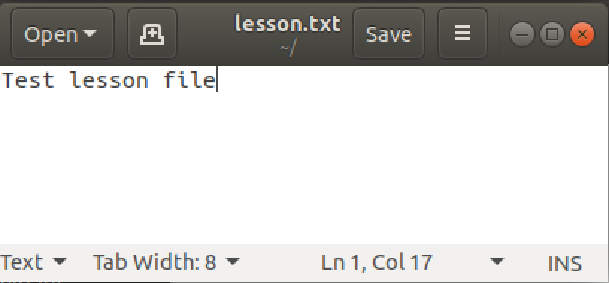
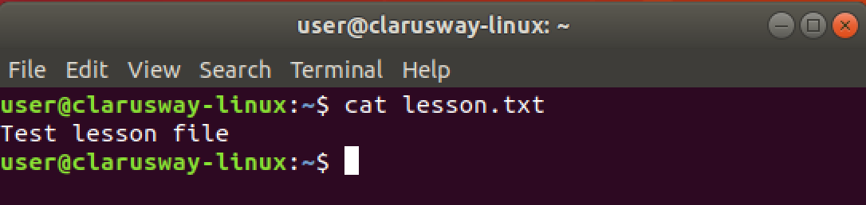
Basic Shell Commands
cat show file contents
cat > [filename] print message into a file
if the file doesn't exist
it creates
cat >> [filename] adds to existing content
Notes:
cat file1.txt file2.txt > file1andfile2.txt

Slide 16
Simple Globbing
Globbing is primarily used to match patterns in filenames or text by using a wildcard character to create a pattern.
Character | Name | Function
? | Question mark | Match any single character
* | Asterisk | Match any number of character(s)
[] | Brackets | Match character from a range
^ | Caret | Used to match starting character
$ | Dollar sign | Used to match ending character
{} | Curly brace | Used to match more than one pattern
| | Pipe | Used for applying more than one condition
Notes:
File globbing is a feature provided by the UNIX/Linux shell to represent multiple filenames by using special characters called wildcards with a single file name. A wildcard is essentially a symbol which may be used to substitute for one or more characters.

Slide 17
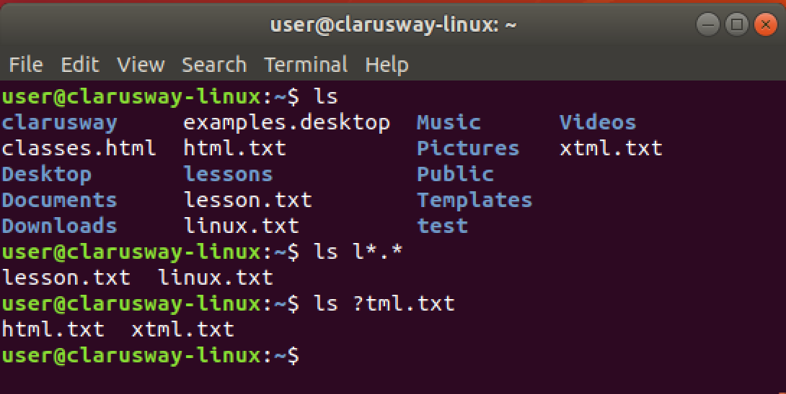
Multiple File/Directory Operations
? used for a single character
* used for multiple characters
Notes:
ls y[abcd]ng.txt
yang.txt
ybng.txt
ycng.txt
ydng.txt
ls post[0-9].tx
rm *.txt
ls ???t.txt 4 characters long and the last character is ‘t’

Slide 18

Basic SHELL Commands
Notes:
There are hundreds of commands on Linux systems and it is not possible for us to explain each of them one by one. You can search internet for cheat sheets and check different commands.
Linux commands may seem intimidating at first glance if you are not used to using the terminal. There are many commands for performing operations and processes on your Linux system.
No matter whether you are new to Linux or an experienced user, having a list of common commands close at hand is helpful.
for exp
The more you use Linux commands, the better you will get at remembering them. Do not stress about memorizing their syntax; use our cheat sheet.;
https://phoenixnap.com/kb/linux-commands-cheat-sheet

Slide 19
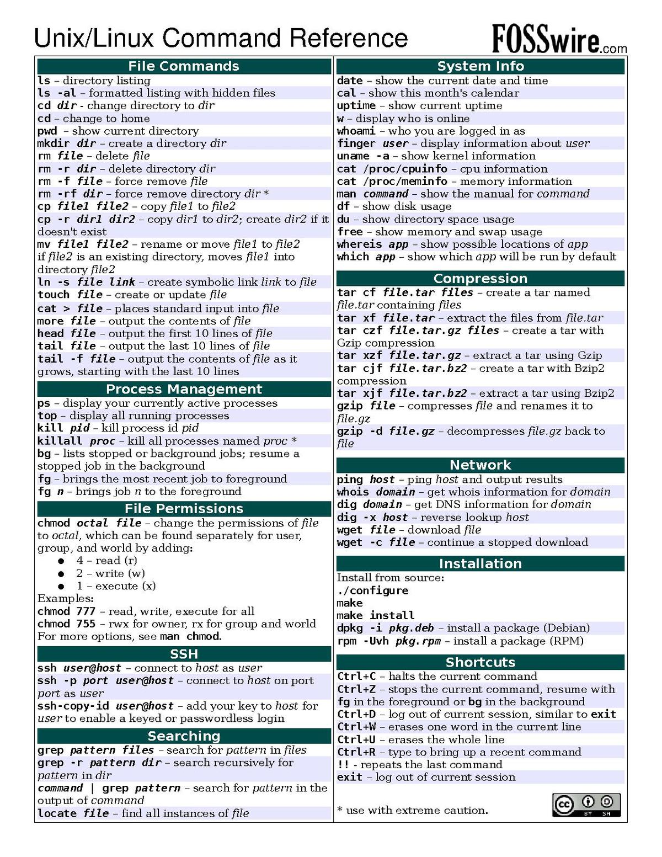
Basic SHELL Commands

Slide 20


Task
clarusway
lessons
linux.txt
"I love linux”
html.txt
“I can create a website”
materials
pre-class
lms.txt
post-class
try-it.txt
Notes:
ls
mkdir clarusway
cd clarusway
mkdir lessons
cd lessons
touch linux.txt
echo "I love linux" >linux.txt
touch html.txt
echo I "can create a website" > html.txt
cd ..
mkdir materials
cd materials
mkdir pre-class
cd pre-class
touch lms.txt
cd ..
mkdir post-class
cd post-class
touch try-it.txt
Short cut 3-4 = mkdir clarusway/lessons
touch lessons/linux.txt

Slide 21
Command Line Basics 2/2
Linux Essentials

Slide 22
Using the Command Line to Get Help
Notes:
For this purposes there are many ways, I just want to show 2 of them respectively ..

Slide 23
Table of Contents
Man Pages
Info Pages

Slide 24
Man Pages
1

Slide 25

Man Pages
man [command]
A man page (short for manual page) is a form of software documentation usually found on a Unix or Unix-like operating system.
if we install a package to do some task, the man Page for that package will typically be installed at the same time. This gives us the ability to take a look at that documentation and make sure that we're using it in a manner consistent with its design.
The man page for a particular command is invoked by preceding the command with man.

Slide 26
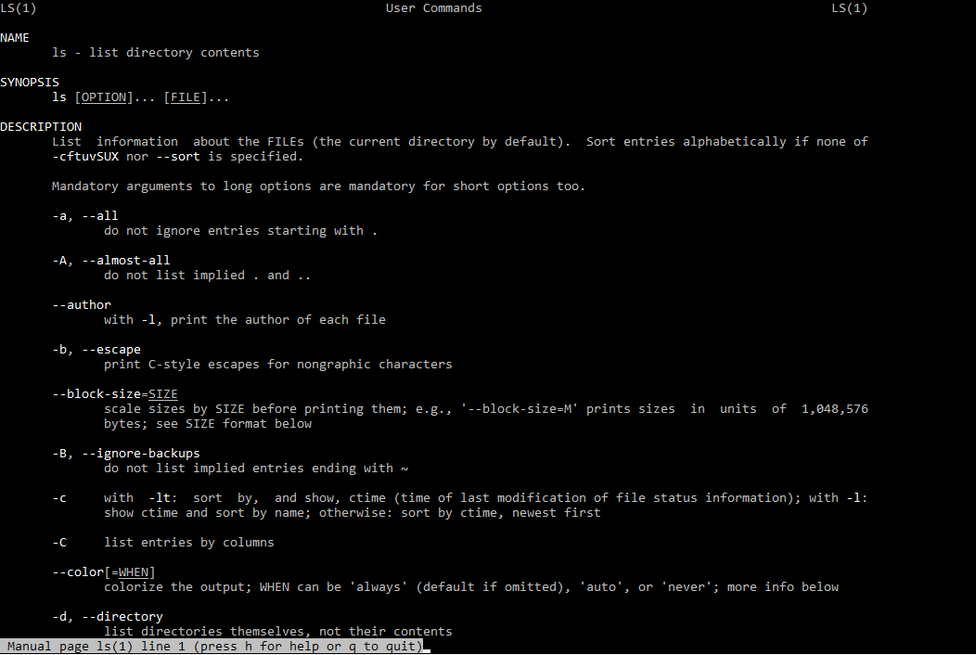
Man Pages
man ls
NAME
Program or Function name(s) followed by descriptions of functionality.
SYNOPSIS
A short overview of available options
DESCRIPTION
Detailed information about arguments and options.
Notes:
NAME
Program or Function name(s) followed by descriptions of functionality.
SYNOPSIS
A short overview of available options
DESCRIPTION
Detailed information about arguments and options.

Slide 27
Info Pages
2

Slide 28
Info Pages
info [command]
Info pages are additional documentation with more robust capability in detail. Info Page normally provides more detailed information about a command than its respective man page. Additionally, Info uses a structure for linking these pages together, and they may be assembled into a larger collection.
The info page for a particular command is invoked by preceding the command with info

Slide 29
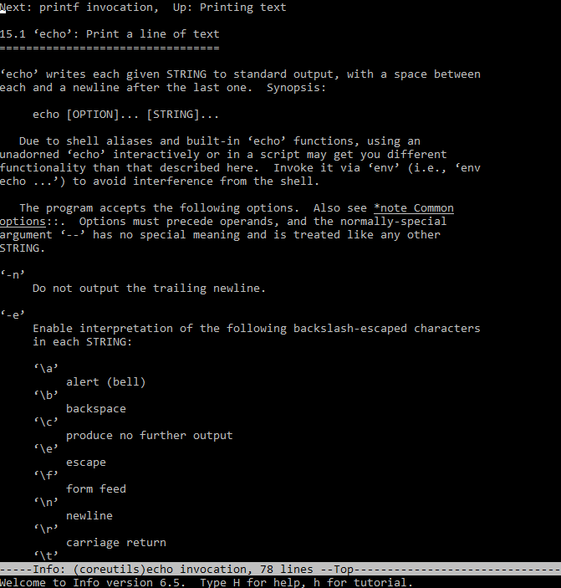
Info Pages
info echo
Notes:
Mkdir –p exercises/man_pages
man ls > man_ls.txt
Man pwd > man_pwd.
txt
t

Slide 30
Text Editors

Slide 31
Vim Editor

Slide 32
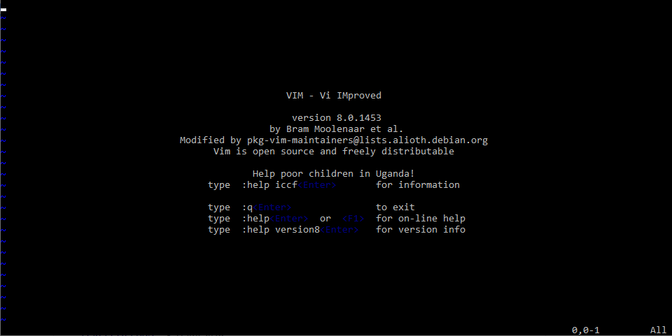
Vim Editor
vim filename
Vim is a powerful text editor used in CLI (command line interface).
Vim is an editor to create or edit a text file.
You cannot write text in command mode. To write text into a file, there is a dedicated insert mode. When you want to write something on a file, you must enter the insert mode.
Insert Mode
When you start Vim, you are placed in Command mode. In this mode, you can move across the screen, delete text and copy text.
Command Mode

Slide 33
Vim Editor
Vim Command | Decription
i | Enter insert mode
Esc | Enter command mode
x or Del | Delete a character
X | Delete character is backspace mode
u | Undo changes
Ctrl + r | Redo changes
yy | Copy a line
dd | Delete a line
p | Paste the content of the buffer
[[ or gg | Move to the beginning of a file
]] or G | Move to the end of a file
:%s/foo/bar/g | Search and replace all occurrences
Esc + :w | Save changes
Esc + :wq or Esc + ZZ | Save and quit Vim
Notes:
sample : https://www.youtube.com/watch?v=bVwgwaDmZp4

Slide 34
Nano Editor

Slide 35

Nano Editor
GNU nano is a small and friendly text editor.
Besides basic text editing, nano offers features like:
undo/redo
syntax coloring
interactive search-and-replace
auto-indentation
line numbers
word completion
file locking, backup files
internationalization support.
Notes:
sudo apt install nano

Slide 36
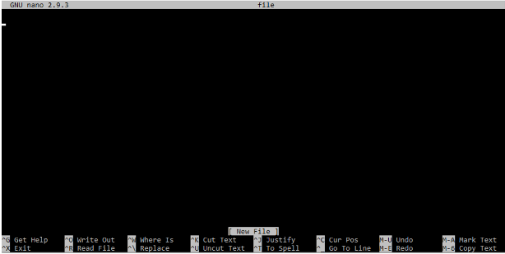
Nano Editor
Nano Command | Meaning
Ctrl G | Get Help
Ctrl X | Exit
Ctrl O | Write Out
Ctrl R | Read File
Ctrl W | Where Is
Ctrl \ | Replace
Ctrl K | Cut Text
Ctrl U | Uncut Text
Ctrl J | Justify
Ctrl T | To Spell
Ctrl C | Cur Pos
Alt U | Undo
Alt E | Redo
Unlike vim, nano is a modeless editor, which means that you can start typing and editing the text immediately after opening the file.
To open an existing file or to create a new file, type nano followed by the file name.
nano filename

Slide 37
Files and Directories
1

Slide 38
Files and Directories
The file system hierarchy standard (FHS) defines the structure of the file systems on Linux.
In the FHS, all files and directories appear under the root directory /, even if they are stored on different physical or virtual devices.
Most of these directories exist in all UNIX, however, they are not considered authoritative for platforms other than Linux.

Slide 39
Files and Directories
/root
Home directory of the root user
/bin
Essential command binaries
/boot
Boot loader files
/dev
Essential device files
/etc
Host-specific configuration files
/home
Users’ home directories
/lib
Libraries essential for the binaries
/mnt
Temporarily mounted filesystems.
/opt
Optional application packages
/proc
Contains information about system
/sbin
Essential system binaries
/tmp
Temporary files
/var
Variable data files

Slide 40
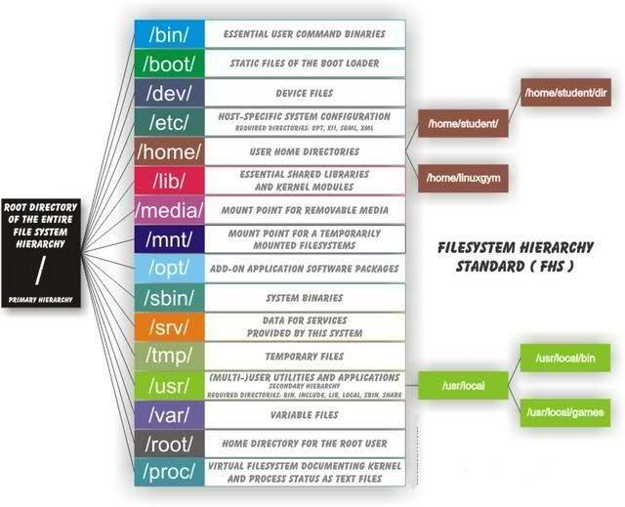
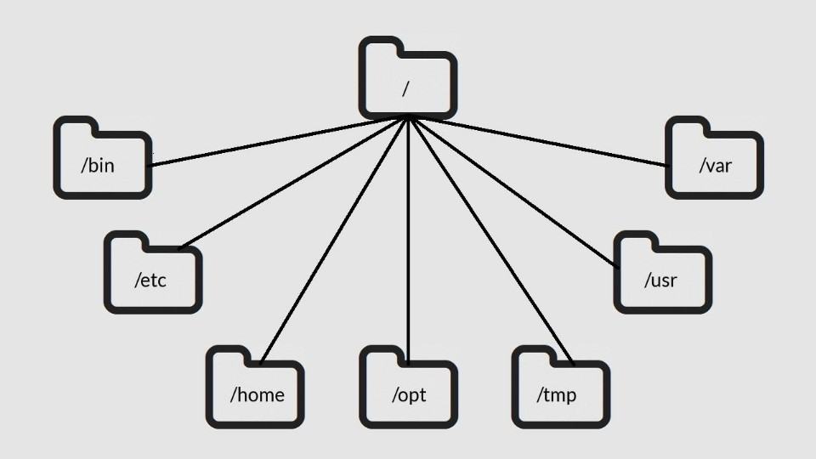
Files and Directories

Slide 41
File Permission
2

Slide 42


File Permission
Ownership
User
Group
Other

Slide 43


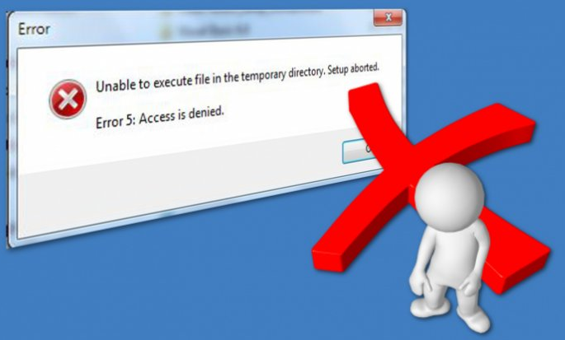
File Permission
Permissions
Read
Write
Execute

Slide 44
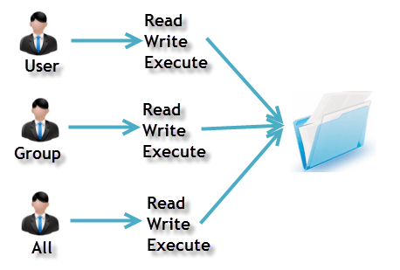
File Permission
Ownership
Permission
A user is the owner of the file.
This permission give you the authority to open and read a file.
User
Read
A user- group can contain multiple users.
The write permission gives you the authority to modify the contents of a file.
Group
Write
Any other user who has access to a file.
you cannot run a program unless the execute permission is set.
Other
Execute

Slide 45
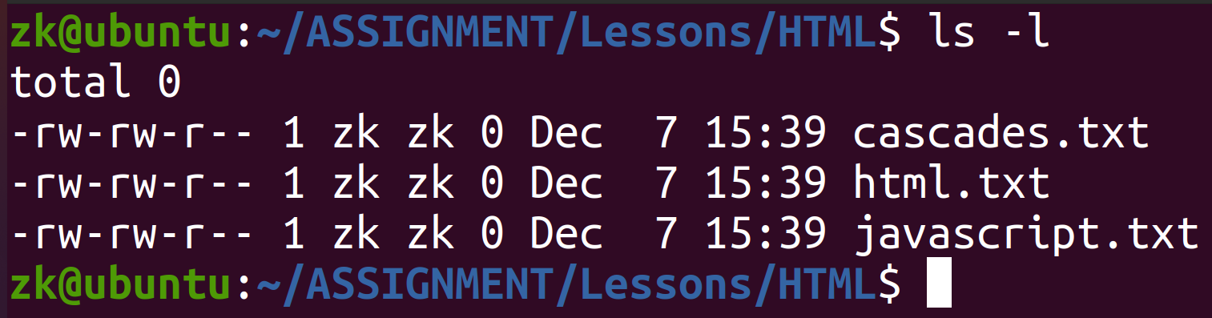
File Permission
Ownership
Other
Group
User

Slide 46
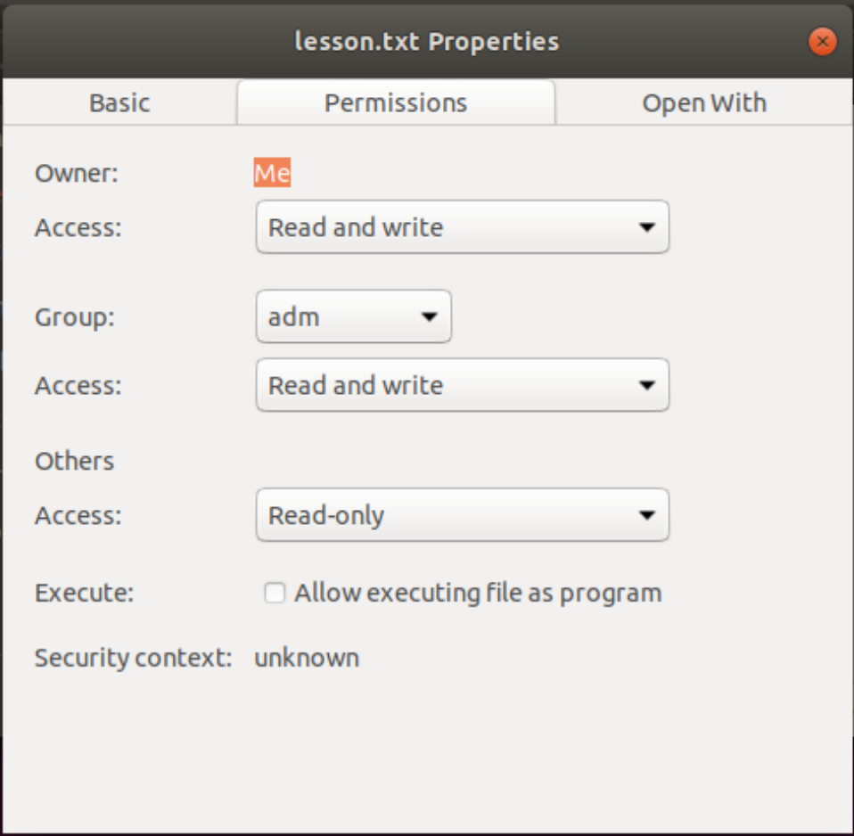
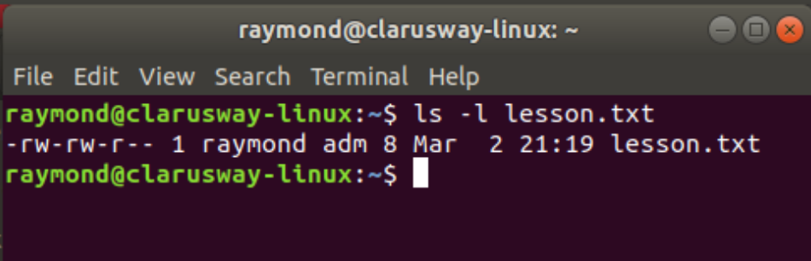
File Permission

Slide 47
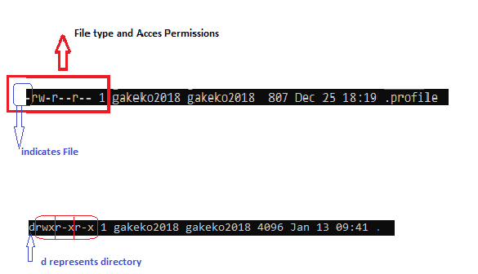
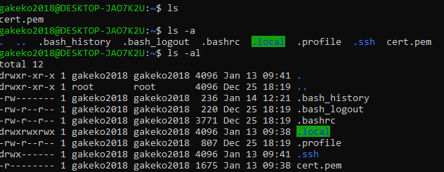
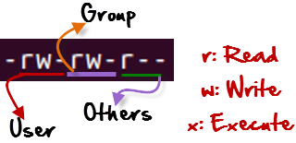
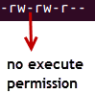
File Permission
r = read permission
w = write permission
x = execute permission
- = no permission

Slide 48
File Permission
Changing Permission with chmod Command
We can use the chmod command which stands for change mode.
we can set permissions (read, write, execute) on a file/directory for the owner, group and the world.
Symbol | Permission Type
--- | No Permission
--x | Execute
-w- | Write
-wx | Execute+Write
r-- | Read
r-x | Read+Execute
rw- | Read+Write
rwx | Read+Write+Execute
chmod permissions filename
chmod u=rwx,g=rx,o=r myfile
Notes:
https://www.howtogeek.com/437958/how-to-use-the-chmod-command-on-linux/

Slide 49
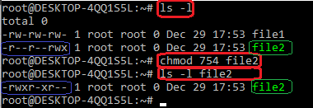
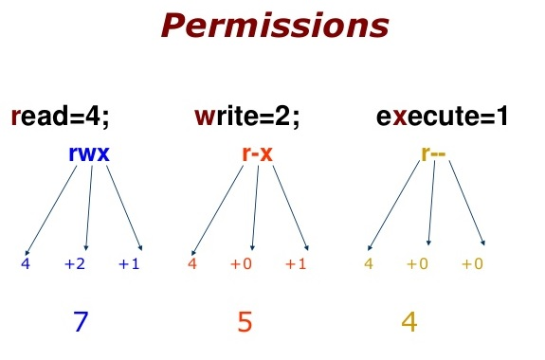
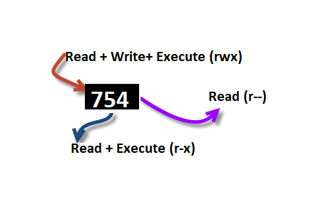
File Permission
754 code says;
Owner can read, write and execute
User’s group can read and execute
Other can only read
chmod u=rwx,g=rx,o=r myfile
chmod 754 myfile

Slide 50
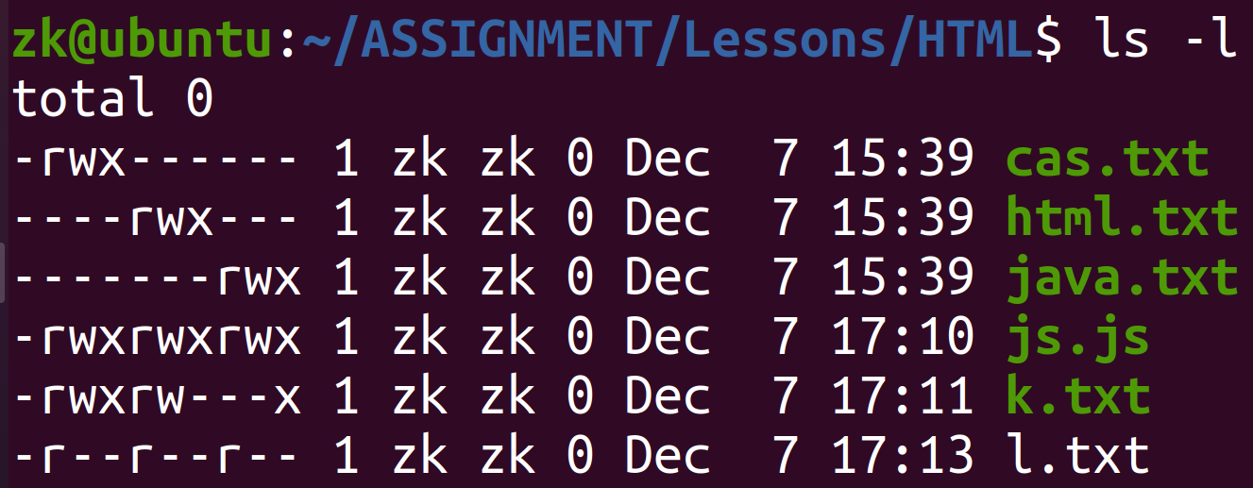
File Permission
!
!

Slide 51
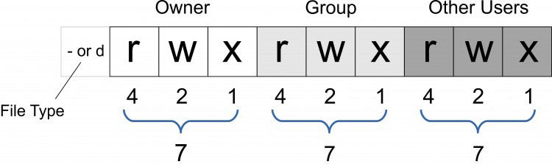
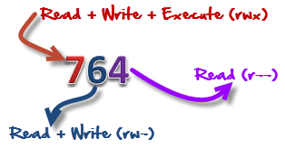
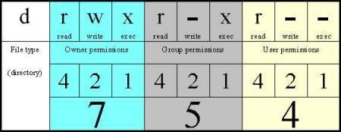
File Permission

Slide 52
Set permissions of myfile.txt to;
owner : full access
group : read and execute
others : no access
Notes:
🍐 This is a Pear Deck Text Slide
🍐 To edit the type of question, go back to the "Ask Students a Question" in the Pear Deck sidebar.

Slide 53
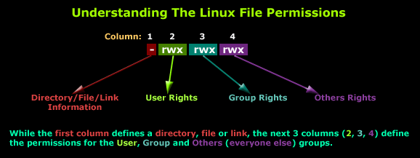
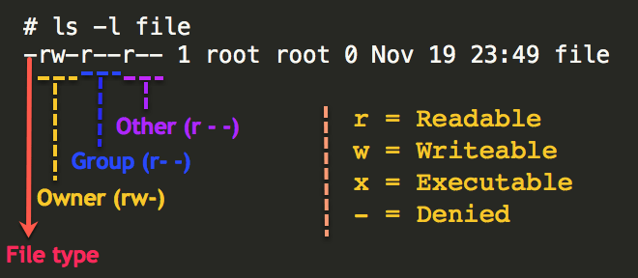
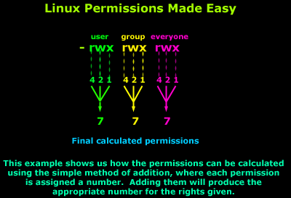

Slide 54
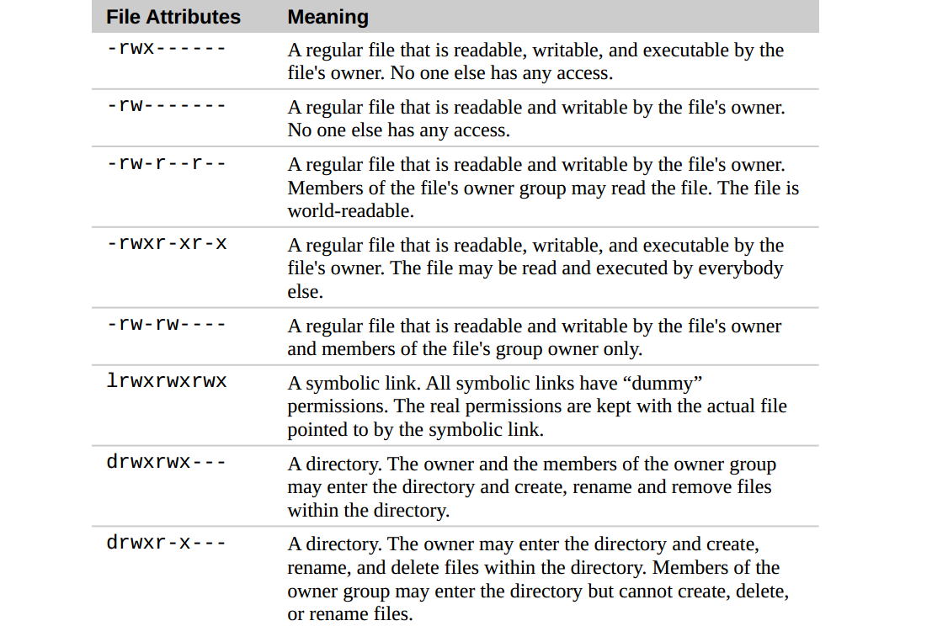

Slide 55
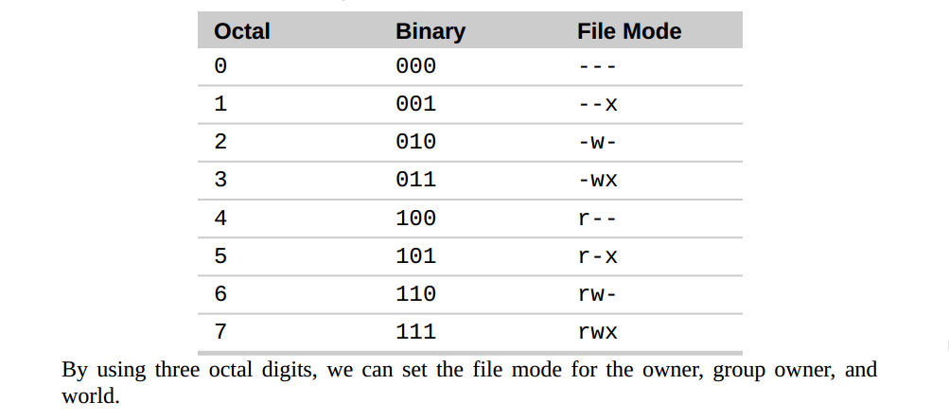

Slide 56
User Operations

Slide 57
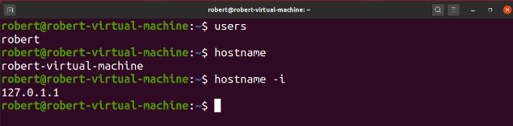
Basic Shell Commands
whoami current user
hostname shows the system hostname
hostname -i show the IP address of the system

Slide 58
User Operations
id
Linux is used to find out user and group names and numeric ID’s
(UID or group ID) of the current user or any other user in the server.
id
returns the current user and groups without any parameters
id [username]

Slide 59
User Operations
su
It is used to change the user account.
sudo [command]
It is used to run commands as root (the most authorized user).
It may ask for a password.
sudo adduser [username]
adduser or useradd commands are used to create a user.

Slide 60
User Operations
sudo userdel [username]
it will just delete the user
sudo userdel -r [username]
The r parameter is used to delete the user with their files.

Slide 61
Users
passwd [username]
changes password
cat /etc/passwd
The user list is in the /etc/passwd file.
File content can be seen with cat command
Notes:
cat /etc/passwd | wc –l Kullanıcı sayısını almak için Linux Çıktı Yönlendirme kullanılarak aşağıdaki gibi elde edilebilir.
veya
wc -l /etc/passwd
Linux kurulumundan sonra en yetkili kullanıcı yerine başka bir kullanıcı oluşturarak kullanmak istenmeyen durumlar için faydalı olacaktır.

Slide 62
User Operations
sudo groupadd [username]
Creates a group
groups
Lists groups
sudo usermod -a -G [group] [username]
assigns the user to a group

Slide 63
Users
groups [username]
Lists the groups that the user is a member of.
sudo groupdel [username]
Deletes the group
cat /etc/group
The user list is in the /etc/group file.
File content can be seen with cat command
Notes:
sudo usermod -L <kullanici>
Kullanıcı kilitleme / dondruma
sudo usermod -U <kullanici>
Kullanıcı kilit kaldırma

Slide 64
Ping & SSH Command

Slide 65
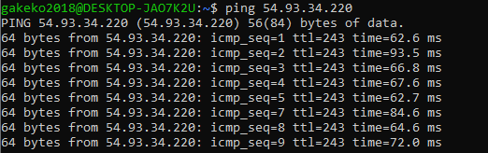
Ping Command
Ping or Packet Internet Groper is a network administration utility used to check the connectivity status between a source and a destination device.
ping host-name/IP
ping 54.93.34.220

Slide 66
Ping Command
The ping command is one of the most used utilities for troubleshooting, testing, and diagnosing network connectivity issues.
Ping works by sending one or more ICMP (Internet Control Message Protocol) Echo Request packages to a specified destination IP on the network and waits for a reply. When the destination receives the package, it will respond back with an ICMP echo reply.
With the ping command, you can determine whether a remote destination IP is active or inactive. You can also find the round-trip delay in communicating with the destination and check whether there is a packet loss.

Slide 67
Ping Command
The ping command resolves the domain name into an IP address and starts sending ICMP packages to the destination IP. If the destination IP is reachable it will respond back and the ping command prints a line that includes the following fields:
The number of data bytes. The default is 56, which translates into 64 ICMP data bytes - 64 bytes
The IP address of the destination - from ….
The ICMP sequence number for each packet. icmp_seq=1
The Time to Live. - ttl=53
The ping time, measured in milliseconds which is the round trip time for the packet to reach the host, and for the response to return to the sender. - time=41.4 ms
By default, the interval between sending a new packet is one second.
The ping command will continue to send ICMP packages to the Destination IP address until it receives an interrupt. To stop the command, just hit the Ctrl+C key combination.

Slide 68
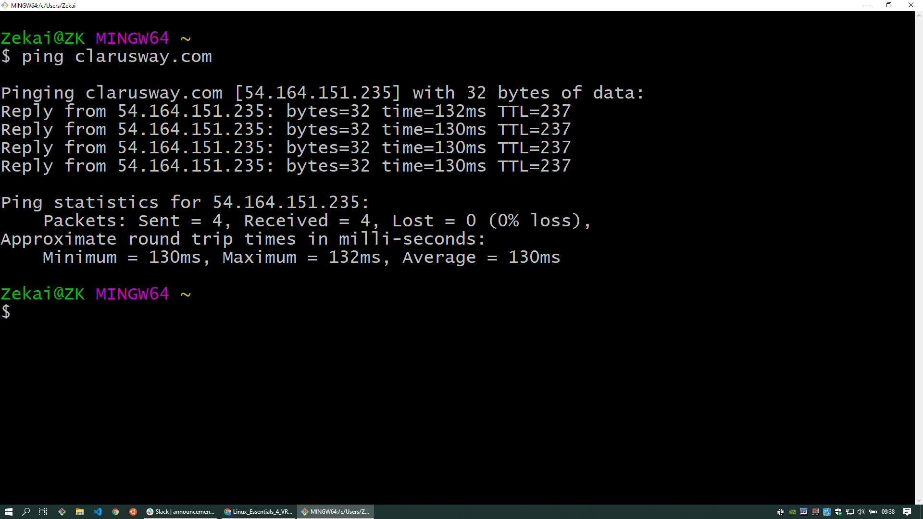
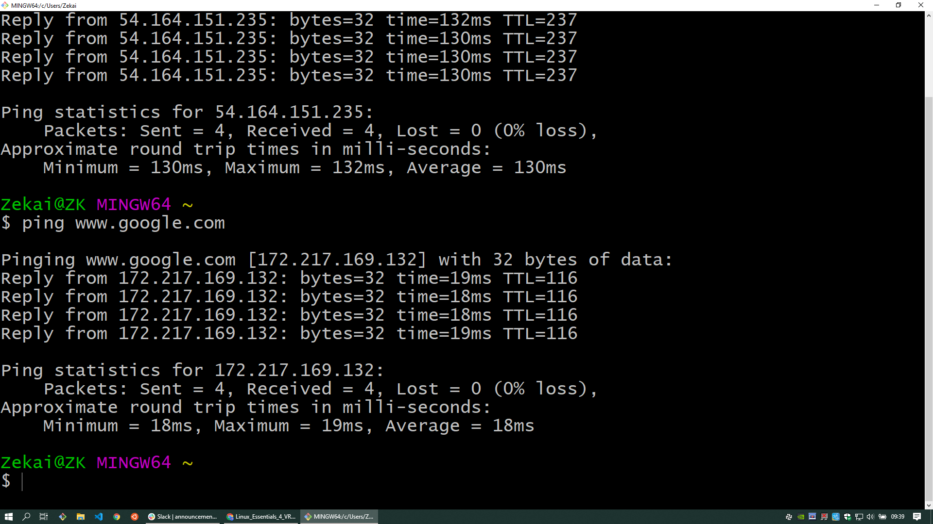
Ping Command

Slide 69
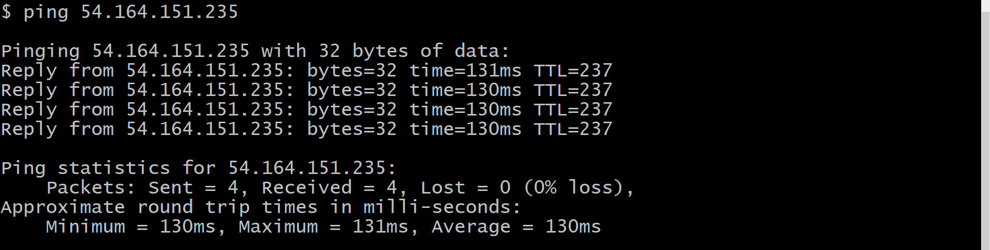
Ping Command

Slide 70
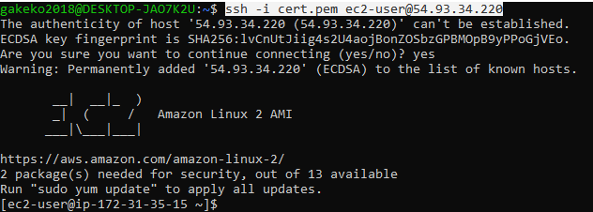
SSH Command
* ssh stands for “Secure Shell”.
* It is a protocol used to securely connect to a remote server/system.
ssh user@host(IP/Domain_name)
ssh -i cert.pem ec2-user@54.93.34.220

Slide 71
THANKS!
Any questions?

